Slide 1

Brief Introduction to Virtual Reality …and Augmented Reality
UNIVERSITY OF ILLINOIS AT URBANA-CHAMPAIGN

Slide 2
vir·tu·al re·al·i·ty
vərCH(əw)əl rē‘alədē
the computer-generated simulation of a three-dimensional image or environment that can be interacted with in a seemingly real or physical way by a person using special electronic equipment, such as a helmet with a screen inside or gloves fitted with sensors.

Slide 3
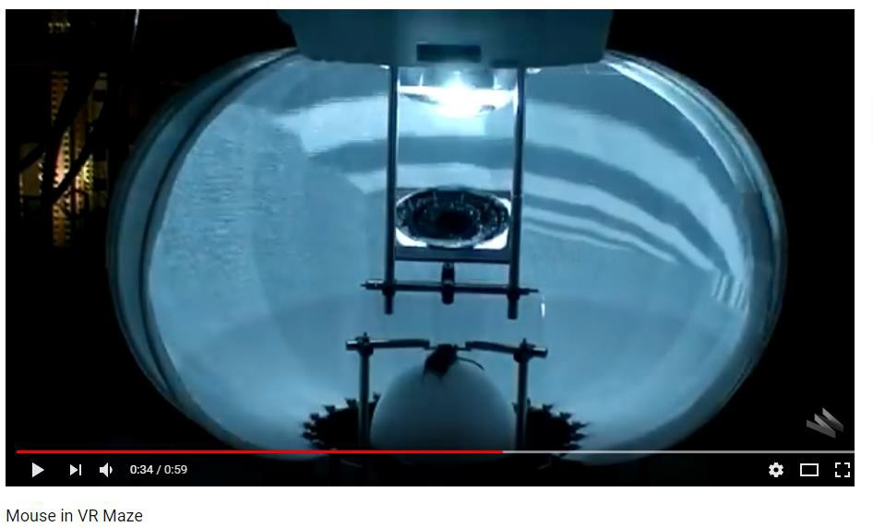
Examples of VR
https://www.youtube.com/watch?v=1DJOTEDBA2c

Slide 4
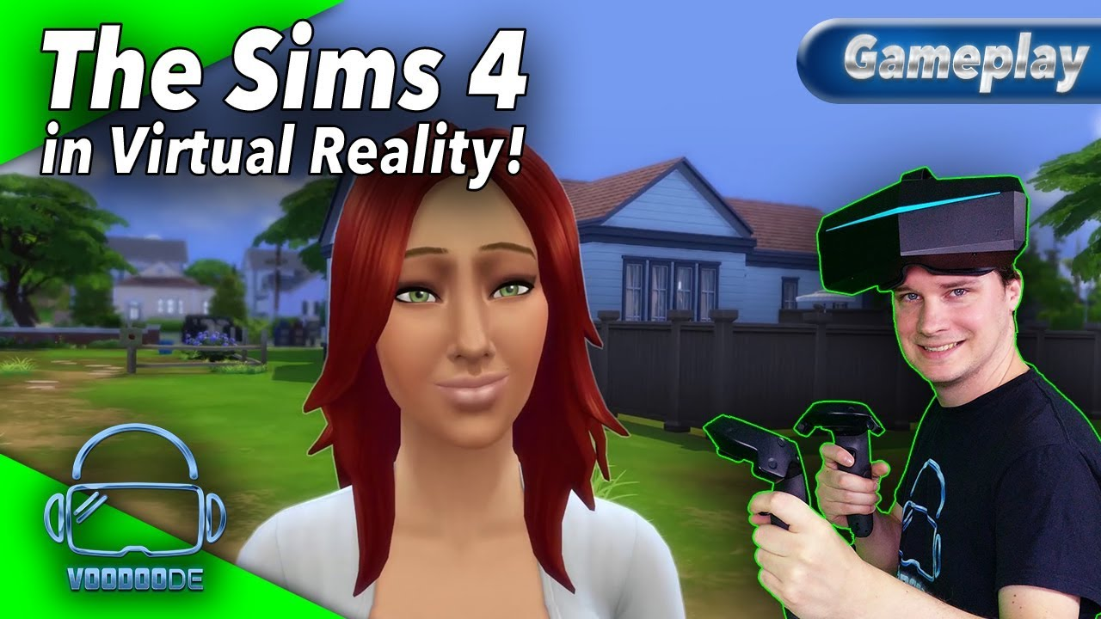
VR Applications… Socializing in Virtual Spaces

Slide 5
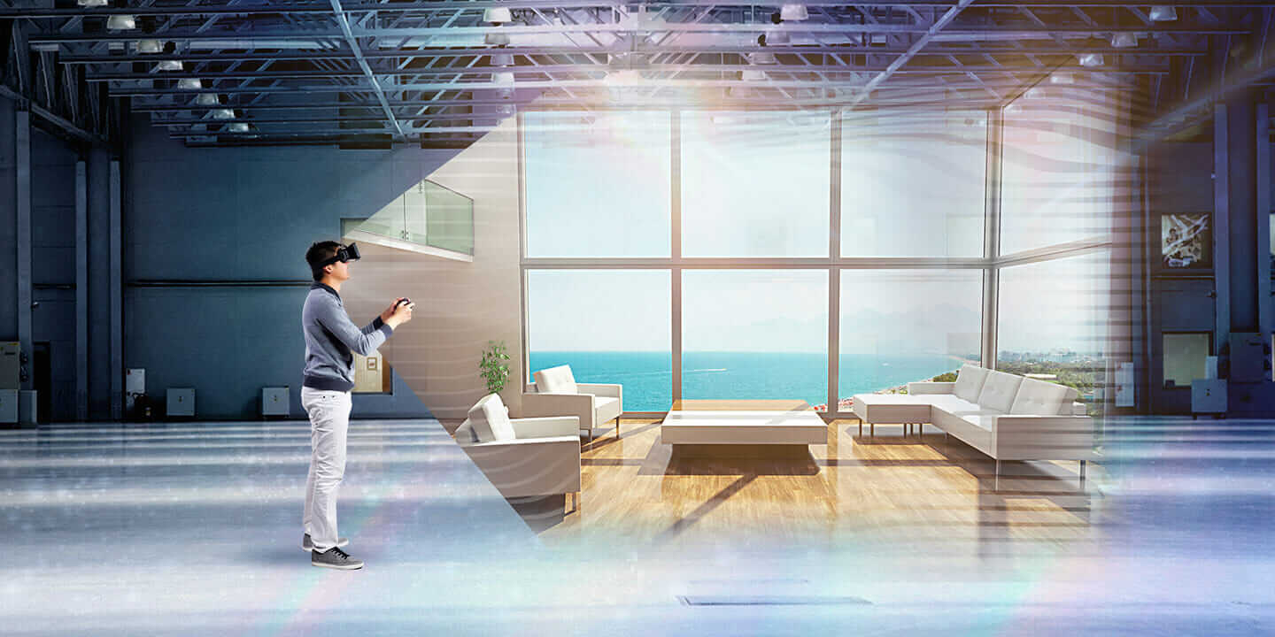
VR Applications… Architecture and Real Estate

Slide 6
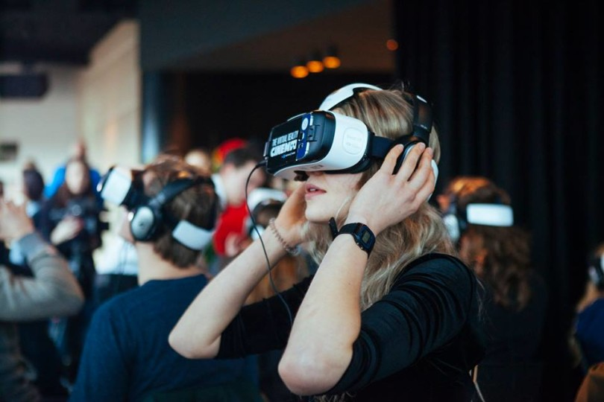
VR Applications…Movies

Slide 7
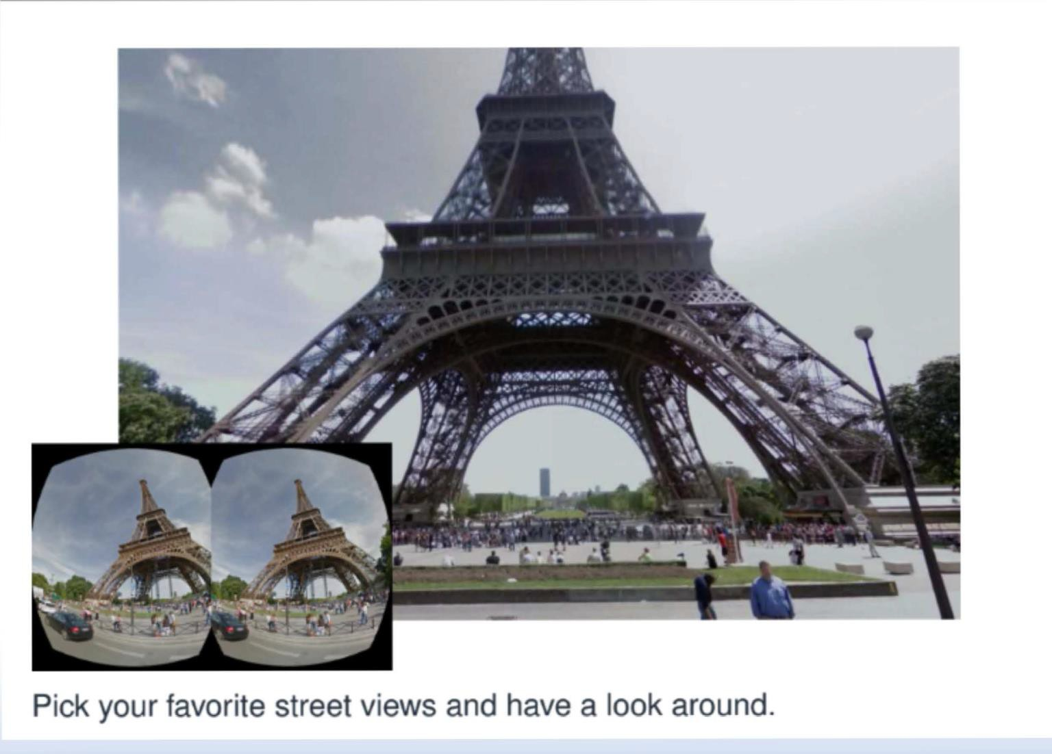
VR Applications…Virtual Touristing

Slide 8
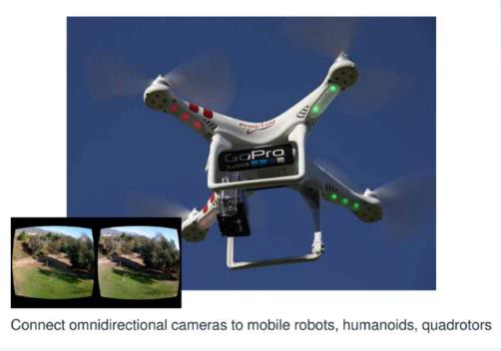
VR Applications…Interacting with Robots

Slide 9
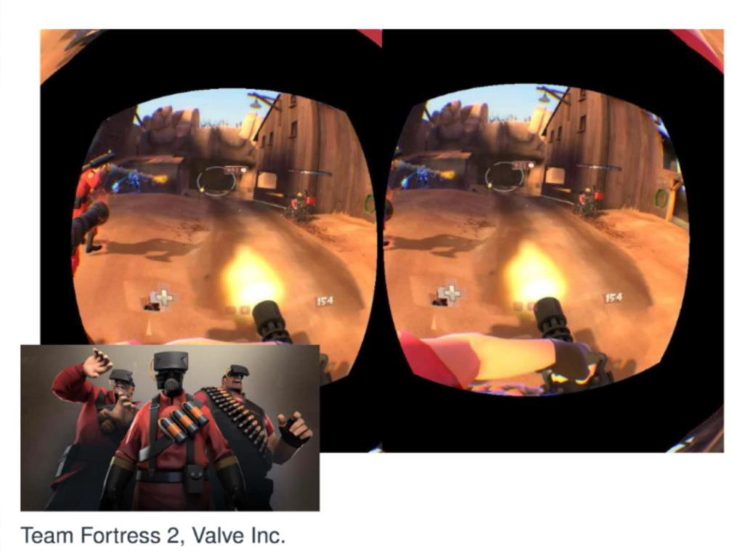
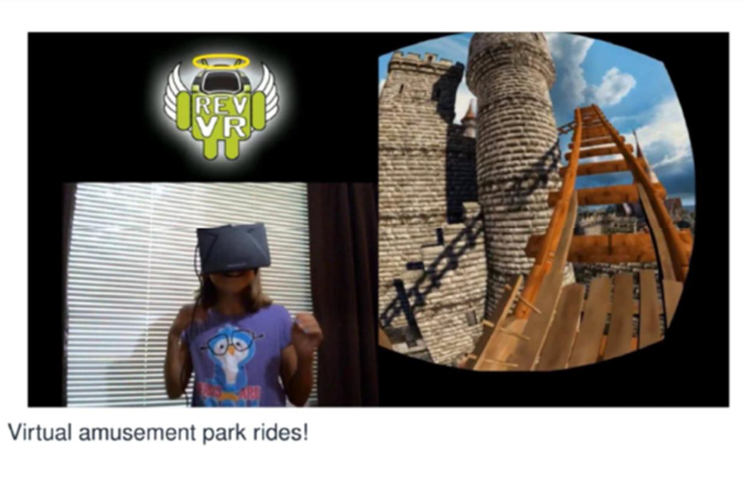
VR Applications…Games

Slide 10
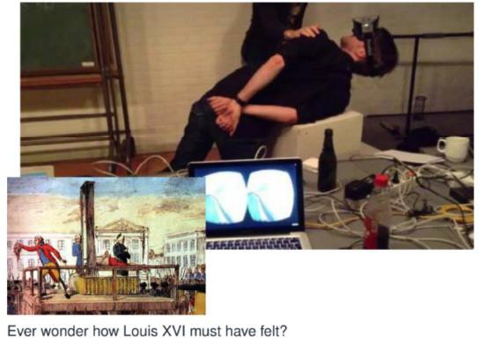
VR Applications…Experiences

Slide 11
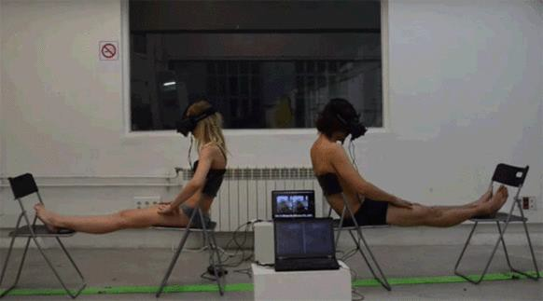

VR Applications… Body Swapping

Slide 12
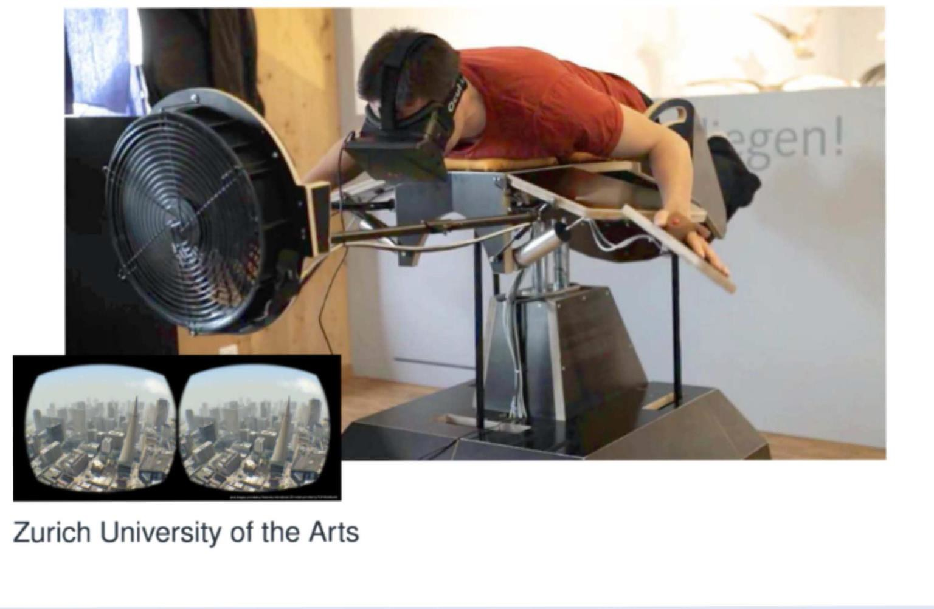
VR Applications…Flying Like in Your Dreams

Slide 13
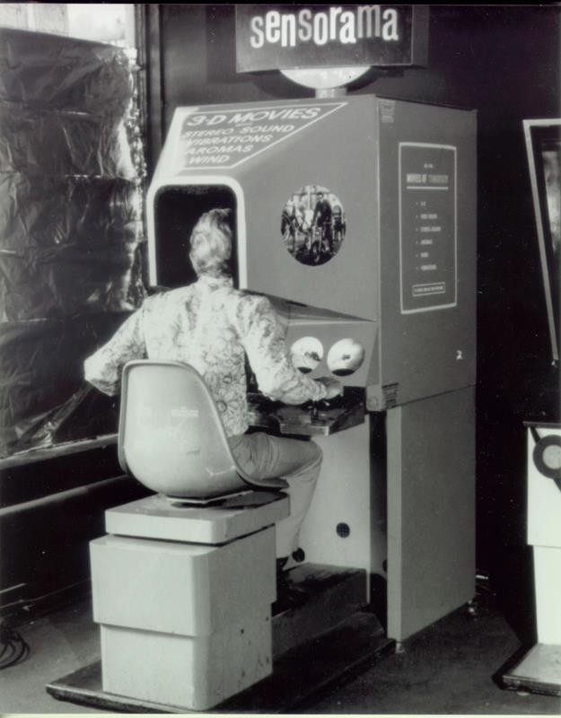
Let’s Answer Some Questions……
What are the components of a VR system?
How does VR work?
What are some popular VR platforms?
What problems remain to be solved?

Slide 14
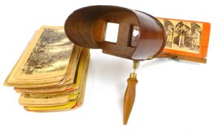
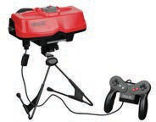
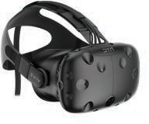
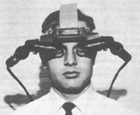




A Brief History of Virtual Reality
Stereoscopes
Wheatstone, Brewster, …
VR & AR
Ivan Sutherland
Nintendo Virtual Boy
VR explosion
Oculus, Sony, HTC, MS, …
???
1838
1968
1995
2012-2019

Slide 15
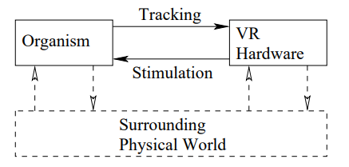
Birds-Eye View: Hardware

Slide 16
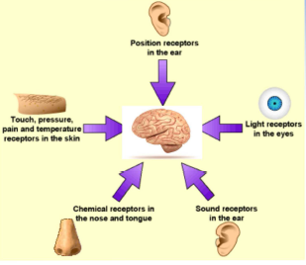
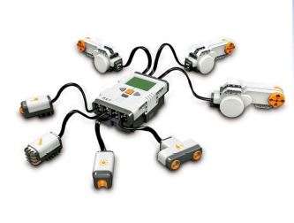
Sensors and Sense Organs
Engineered Components
Transducer: Converts energy from one form to another
Sensor: Transducer converting energy into an electrical signal
Receptor: Part of sensor that collects energy
Sense organs are like biological sensors that convert stimuli into neural impulses

Slide 17
Quick Aside: Why two ears in the diagram?

Slide 18
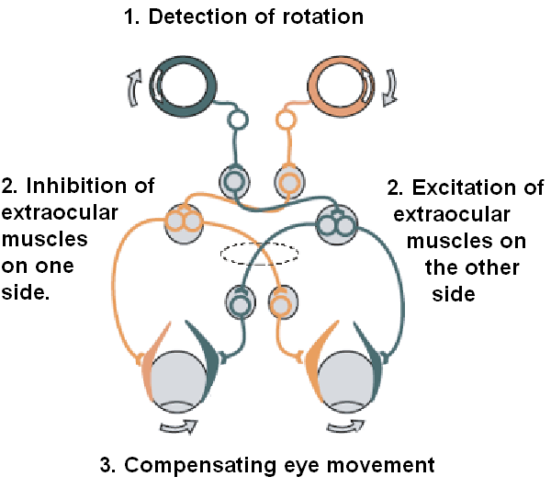
Quick Aside: Why two ears in the diagram?
The vestibular system, in most mammals, is the sensory system that provides the leading contribution to the sense of balance and spatial orientation for the purpose of coordinating movement with balance. Together with the cochlea, a part of the auditory system, it constitutes the labyrinth of the inner ear in most mammals. As movements consist of rotations and translations, the vestibular system comprises two components: the semicircular canals which indicate rotational movements; and the otoliths which indicate linear accelerations. -- Wikipedia

Slide 19
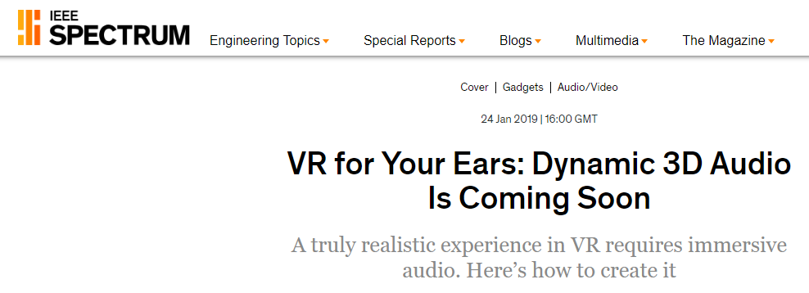
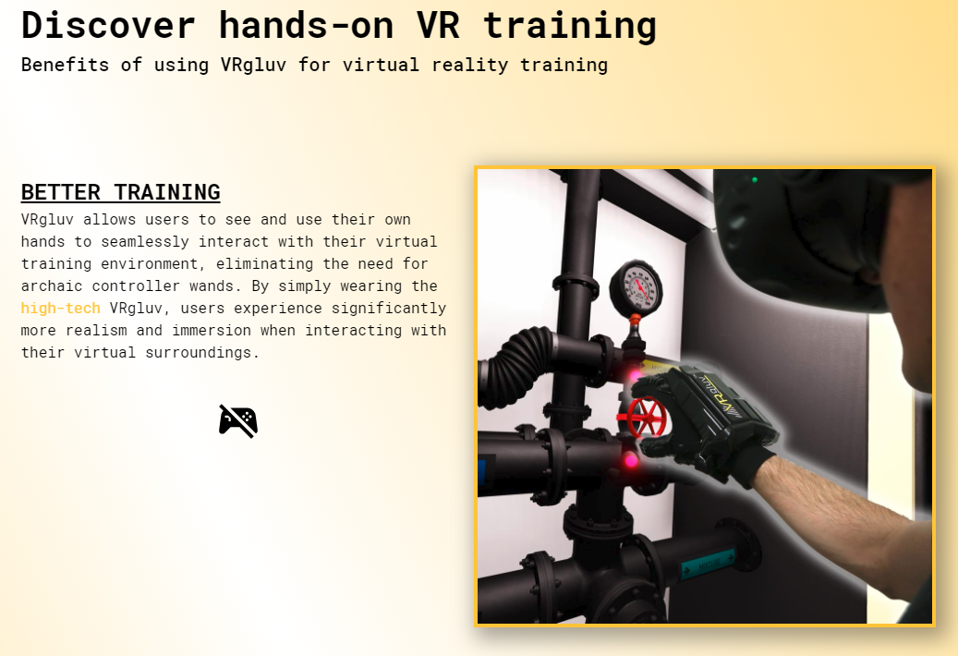
Displays
A display is output device designed to stimulate a sense
We will focus on visual display, but other displays are just as important for true VR

Slide 20
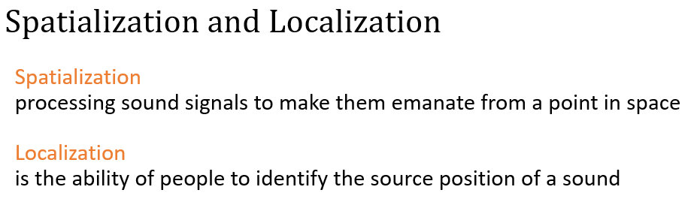
Aural Displays
Main cues used by humans to localize sound:
Interaural time differences: Time difference for sound wave to travel between ears
Interaural level differences: For high frequency sounds (> 1.5 kHz), volume difference between ears used to determine source direction
Spectral filtering done by outer ears: Ear shape changes frequency heard
Capturing a Head-Related Transfer Function

Slide 21
Your Thoughts
How else do we need to process the audio for realistic VR?

Slide 22
Sound Reverberation
• Need to consider first and second order reflections
• Need to model material properties, objects in room, etc

Slide 23
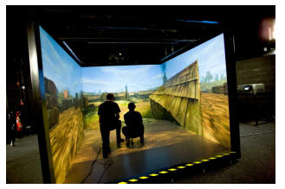
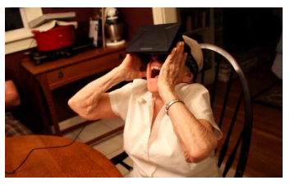
Visual Displays
Two Settings:
World-fixed
User-fixed
For a user-fixed visual display we need to process the displayed scene in response to user movement.
How do we need to transform the geometry when someone rotates their head to their right?
The inability measure head movement accurately – and the VR sickness that failure produced – is one of the main failings of 1990s era VR technology.

Slide 24
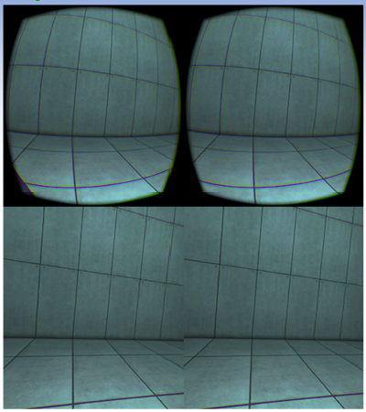
Hardware: Lens
Why do HMDs use lenses?
What issue arises that must be dealt with?
FOV: __________________________________________________________
Distortion: ______________________________________________________

Slide 25
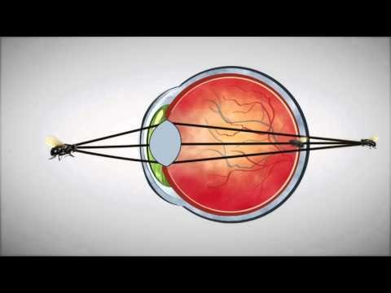
Hardware: Lens
https://www.youtube.com/watch?v=NCBEYaC876A

Slide 26
Hardware: Lens
Why do HMDs use lenses?
To enable the human eye to focus on the display
What issue arises that must be dealt with? Distortion …for example, straight lines not appearing straight
FOV: __________________________________________________________
Distortion: ______________________________________________________

Slide 27
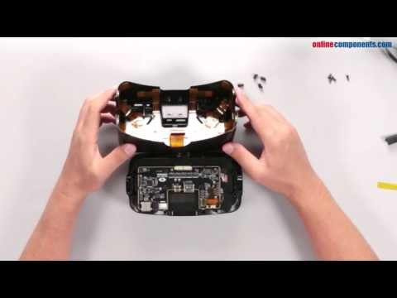
Oculus DK2 Teardown
https://www.youtube.com/watch?v=Lfytw8VQGJc

Slide 28
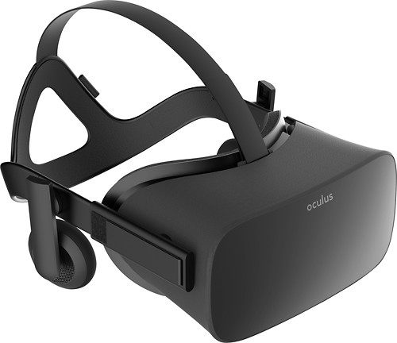
Tracking Hardware
The VR system needs to track the position and orientation of the head in the HMD
This is typically done using both Inertial Measurement Unit (IMUs) and cameras
Tracking is: _____________________________________________________
HMD vs Cave
HMD vs Headphones
Notes:
Tracking is: Updating the virtual world according to configuration changes of the sense

Slide 29
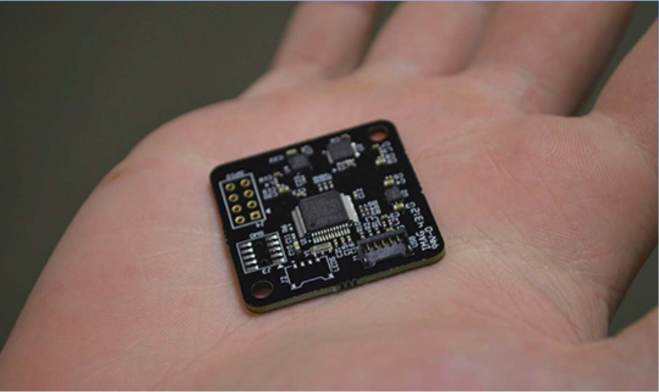
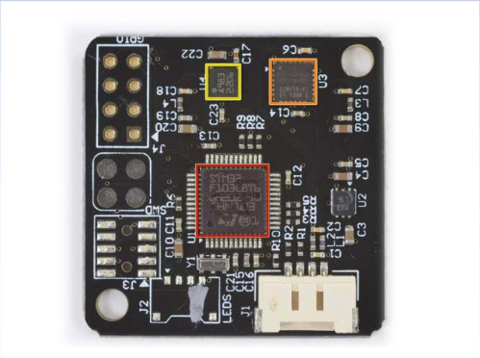
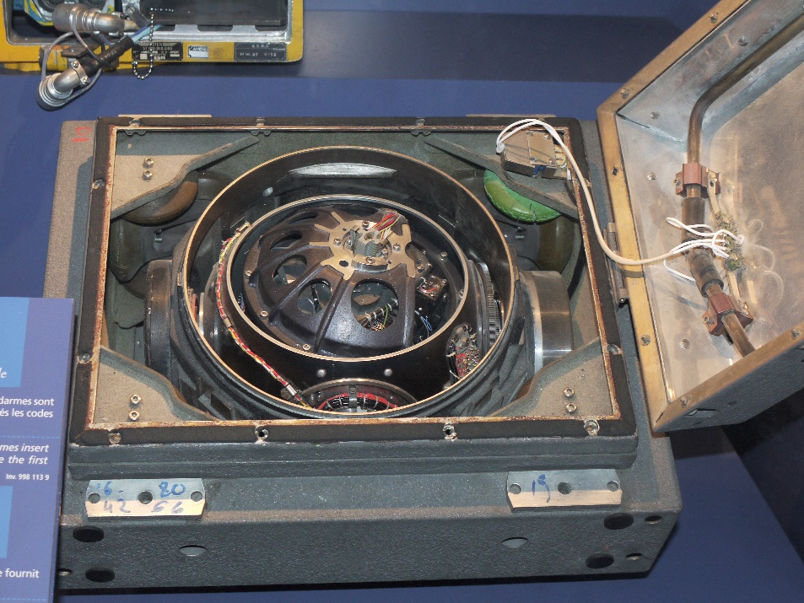
Tracking Hardware: IMUs
Include a gyroscope
An accelerometer
A magnetometer
Used to be much larger…
By Pline - Own work, CC BY-SA 3.0, https://commons.wikimedia.org/w/index.php?curid=5854735
Used for:
Consists of:
Common in:
Cost:
Notes:
IMU’s: Inertial measurement units
Consists of:
Gyroscope
Accelerometer
Magnetometer
Common in: airplanes
Cost: $ - $$$

Slide 30
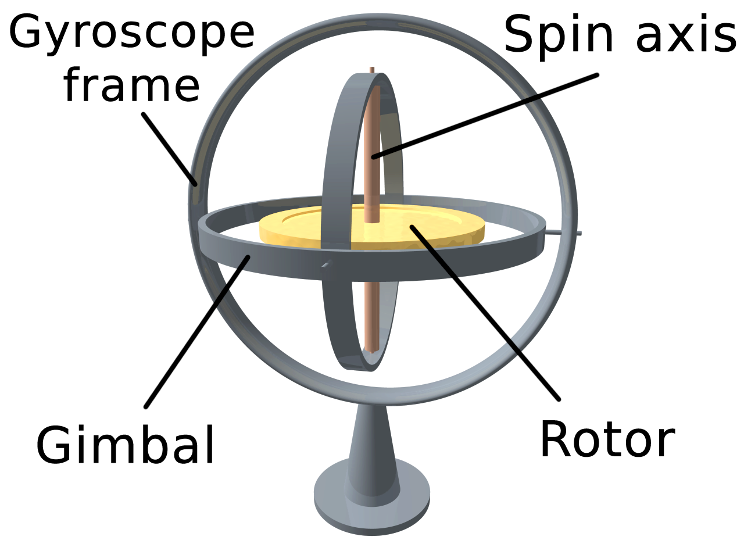
Gyroscope
Gyroscope measures angular velocity
Modern hardware uses MEMS-based gyroscopes that measure the effect of rotation on a vibrating object
What motion can we track with the gyroscope?

Slide 31
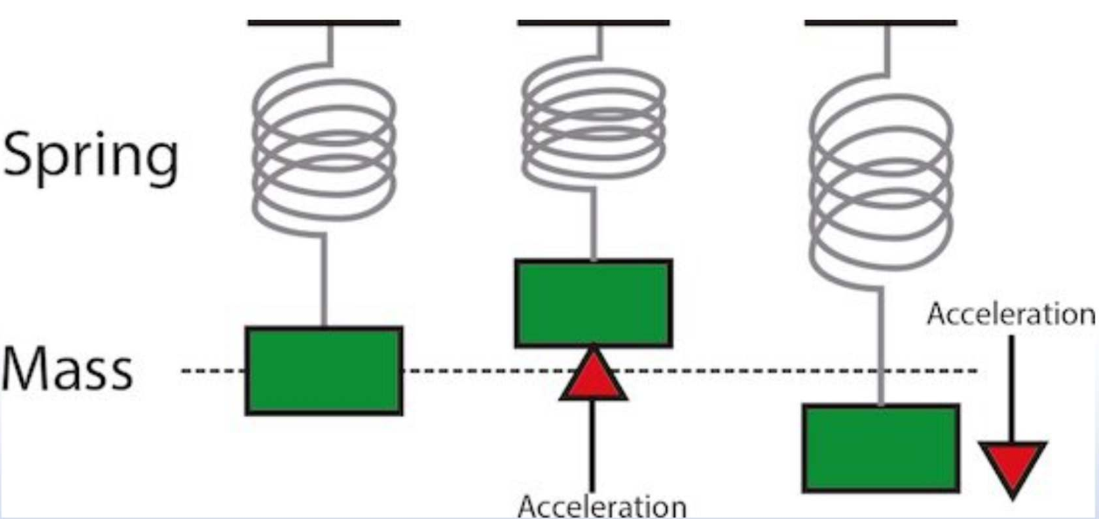
Tracking Hardware: Accelerometers
Used to correct “tilt” error…any idea how?
Conceptually, an accelerometer behaves as a damped mass on a spring. When the accelerometer experiences an acceleration, the mass is displaced to the point that the spring is able to accelerate the mass at the same rate as the casing. The displacement is then measured to give the acceleration. Modern accelerometers are often small micro electro-mechanical systems (MEMS), and are indeed the simplest MEMS devices possible --Wikipedia
Notes:
IMU’s contain gyroscope + accelerometer

Slide 32
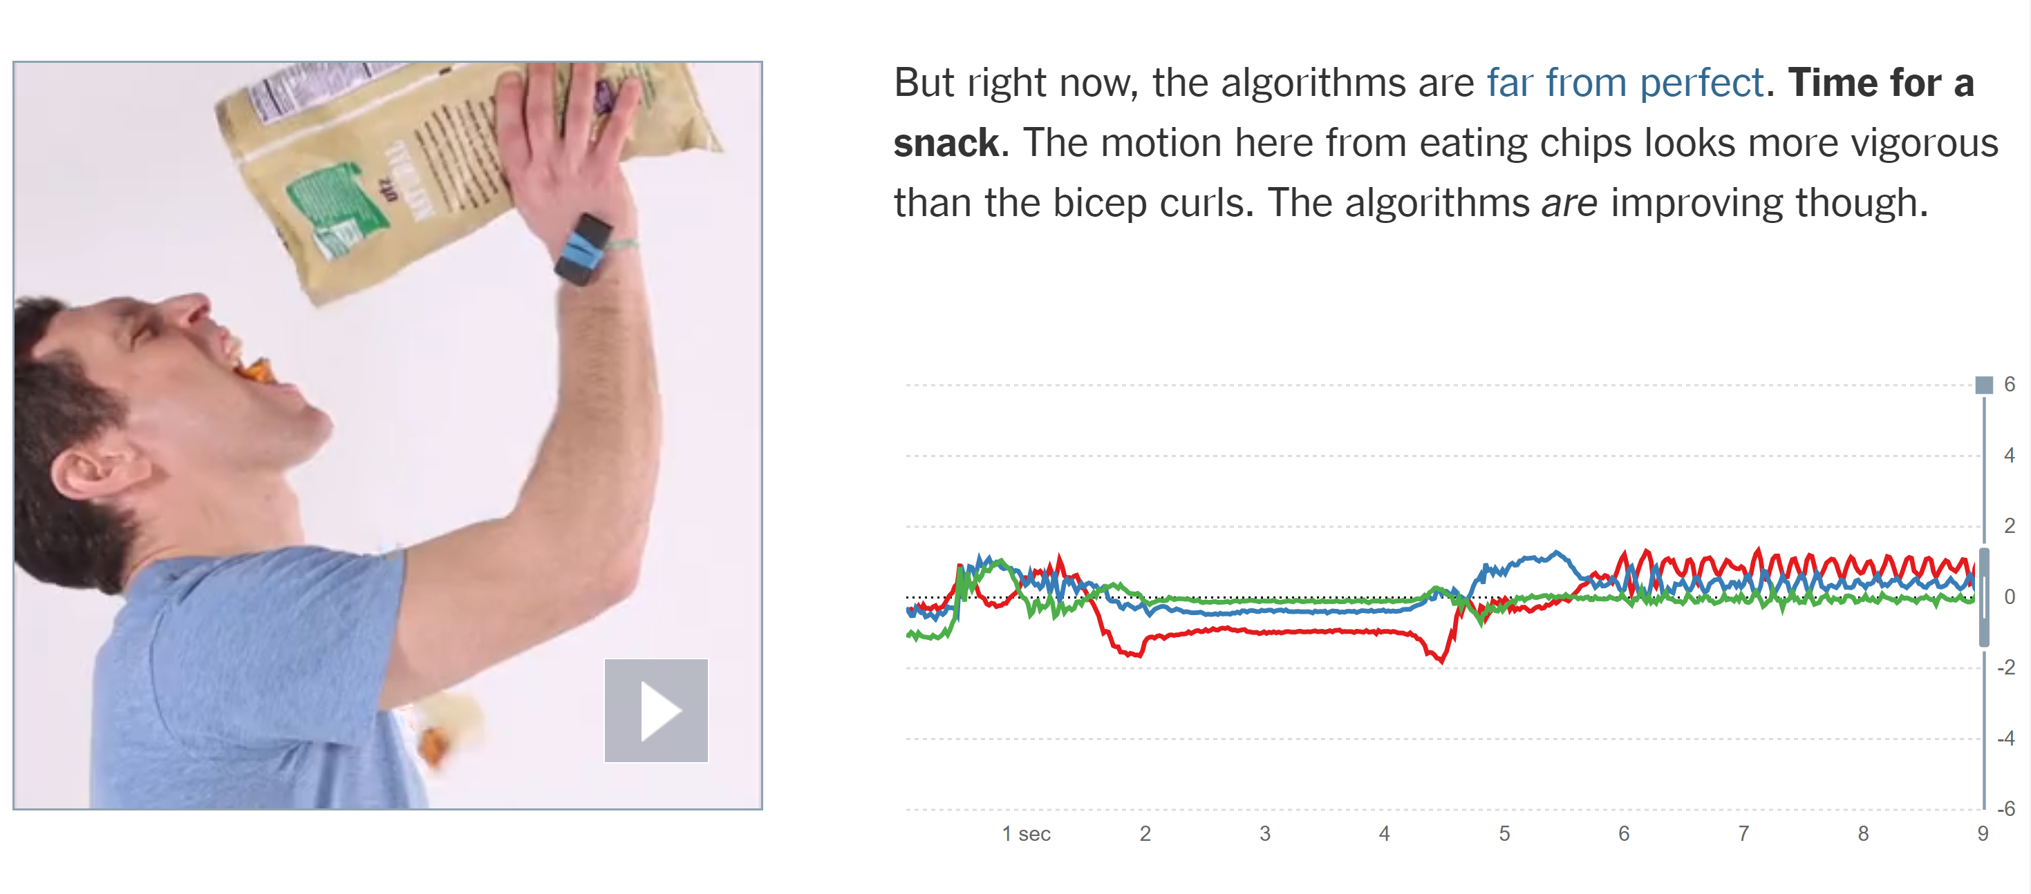
Fun Facts about Accelerometers
https://www.nytimes.com/interactive/projects/well/2014/03/accelerometers.html

Slide 33
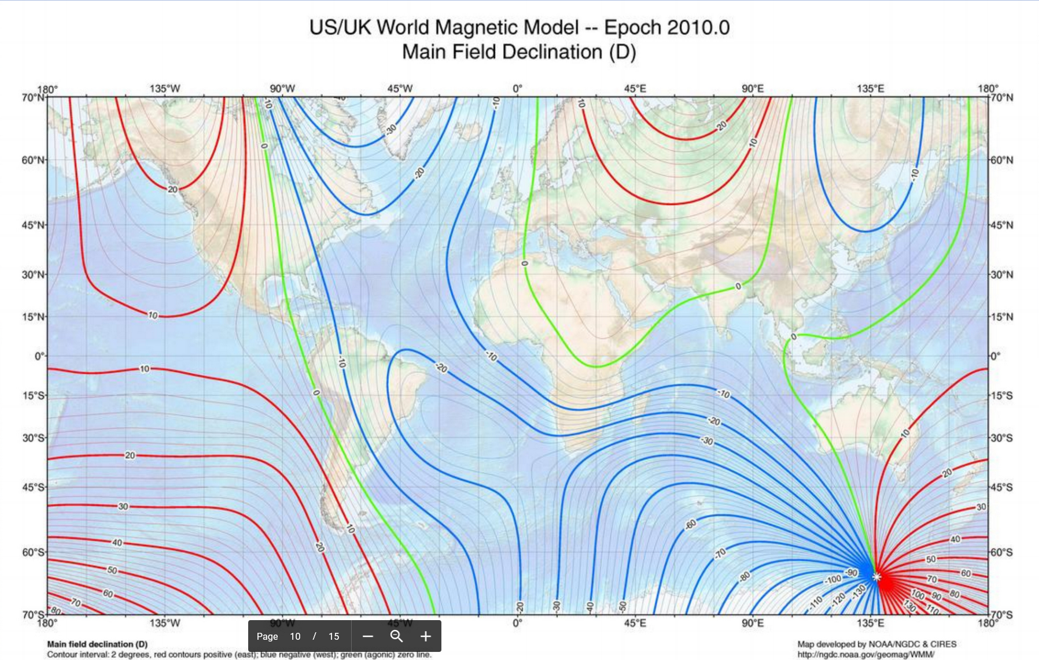
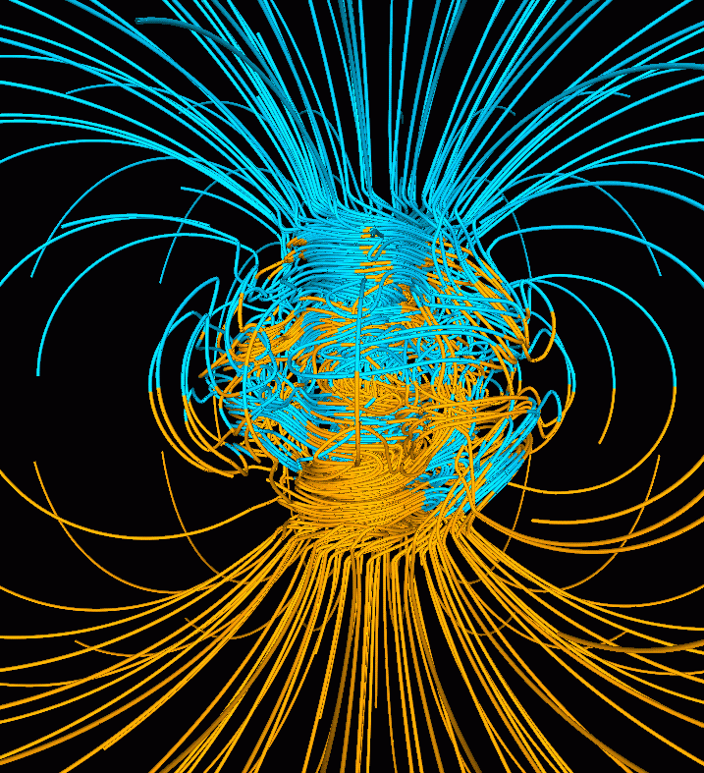
Tracking Hardware: IMUs
Vector magnetometers measure the vector components of a magnetic field….such as the Earth’s magnetic field.
Used to correct yaw error…any idea how?
Notes:
On the left - Inclination angles: Computer simulation of the Earth's field in a period of normal polarity between reversals.^{[1]} The lines represent magnetic field lines, blue when the field points towards the center and yellow when away. The rotation axis of the Earth is centered and vertical. The dense clusters of lines are within the Earth's core.^{[2]}
On the right - Declination angles: magnetic declination is the angle on the horizontal plane between magnetic north and true north

Slide 34
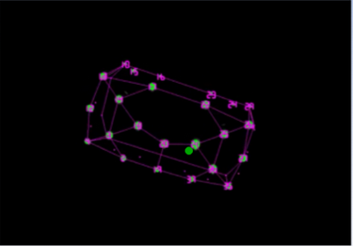
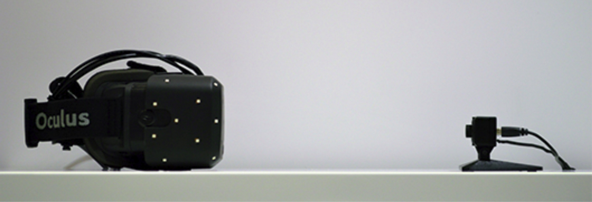
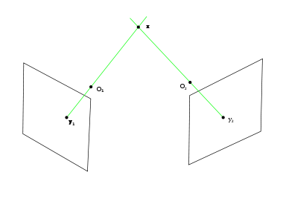
Tracking Hardware: Cameras
An infrared camera can be used to detect the position of IR on the headset.
Depth can be estimated in multiple ways…two cameras can find depth through triangulation
Notes:
This is an example of outside-in tracking.
Inside out tracking has the camera on the HMD and scans the world for cues

Slide 35
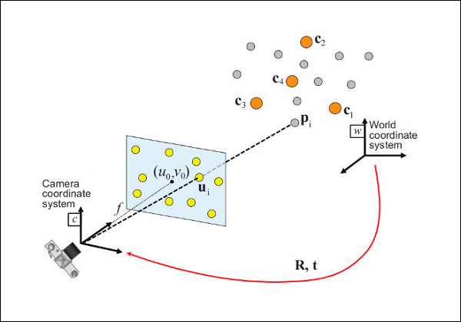
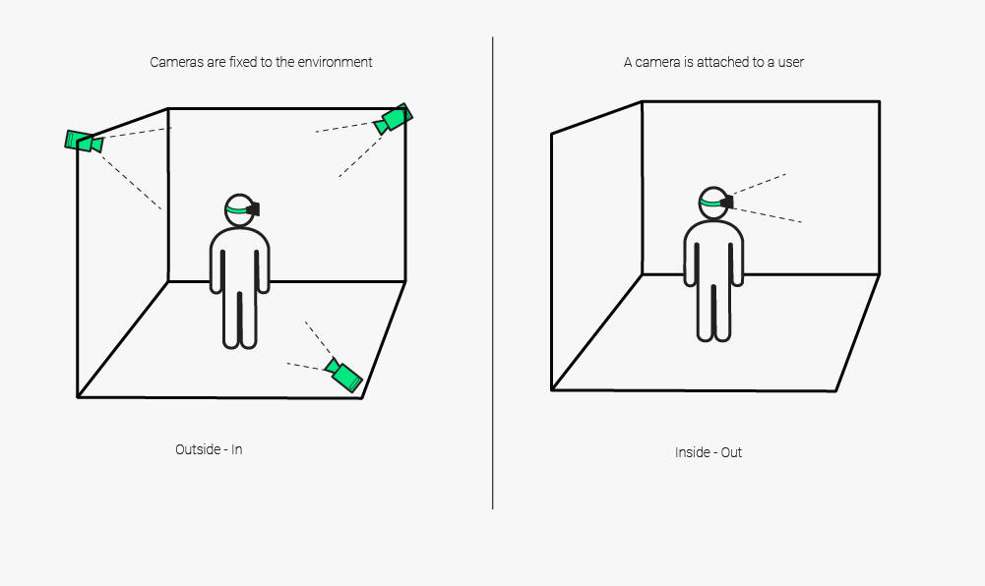
Inside-Out Tracking
Use of computer vision techniques to compute pose for the HMD
State-of-the-art….used in Oculus Quest

Slide 36
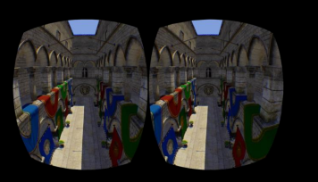
3D Computer Graphics: Why does it look 3D?

Slide 37
Why does it look 3D?
Shading
Perspective rendering
Binocular disparity

Slide 38
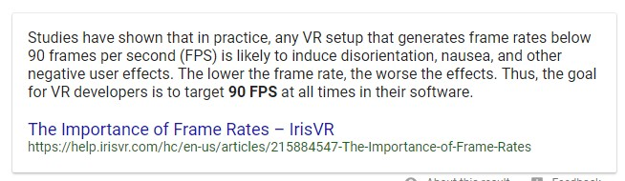
How many FPS are enough?
But ultra-realism demands…
More FPS
Less latency
More Pixels
Greater Field-of-View

Slide 39

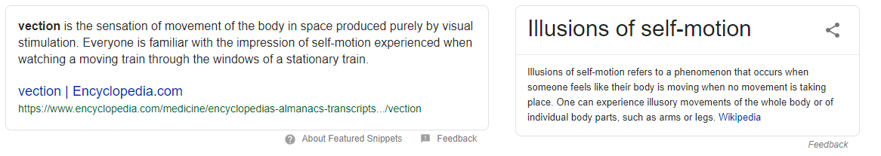
Problem with VR: Vection

Slide 40
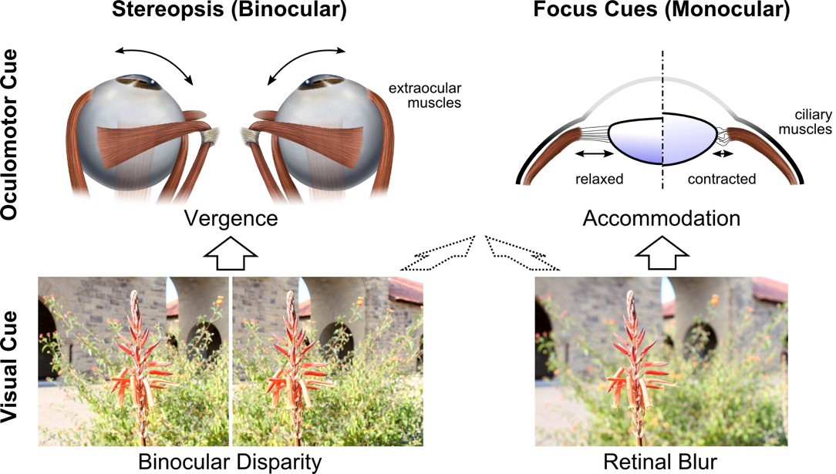
Problem with VR: Vergence-Accommodation Mismatch

Slide 41
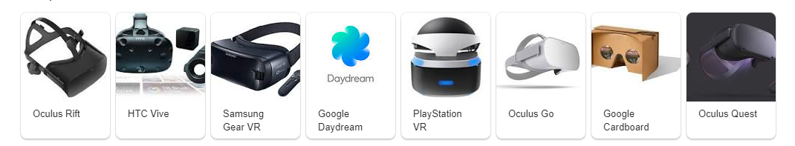
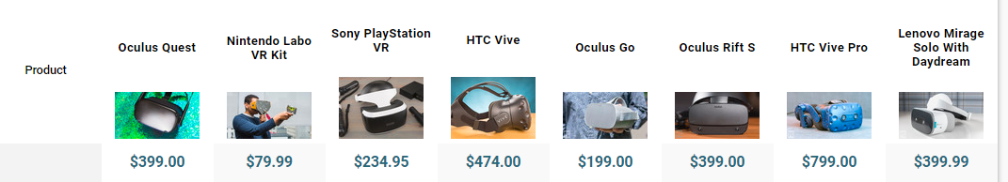
Current Consumer VR Technology

Slide 42
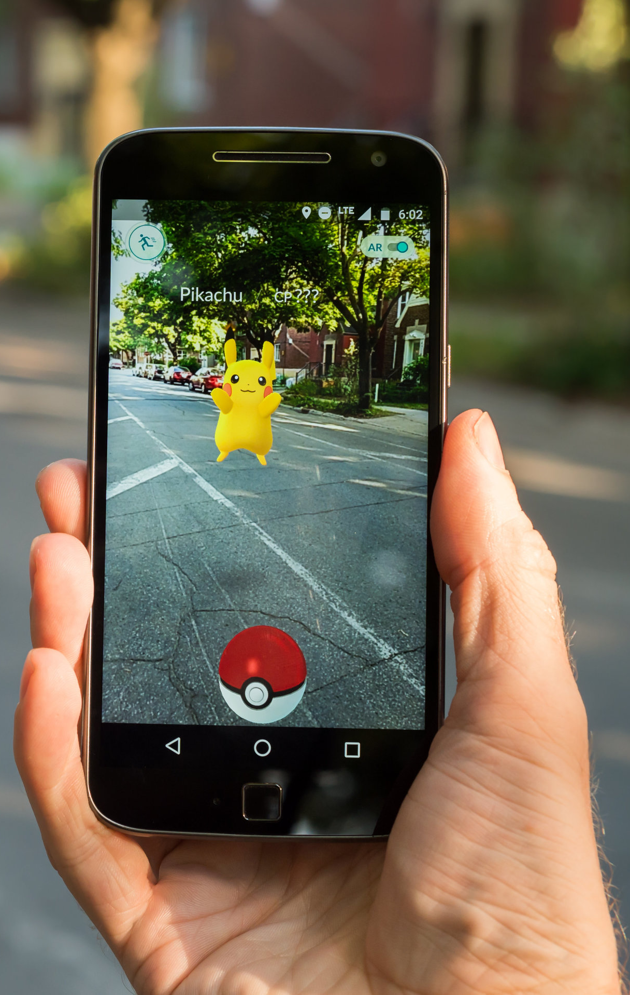
What Is Augmented Reality (AR)?
AR combines a real scene augmented by
a virtual objects generated by a computer that provide with additional information.

Slide 43
Augmented Reality and Mixed Reality and Virtual Reality
AR
System augments the real world scene with virtual elements
Needs a mechanism to combine virtual and real worlds
Hard to register real and virtual worlds
MR
Like AR but you can interact with the virtual element
VR
Totally immersive synthetic environment
Need a mechanisms to generate fully synthetic environment
Hard to provide consistent stimuli
Notes:
Computer generated virtual objects must be accurately registers with the real
in all dimensions.
Errors in registration prevent the real and virtual images from being seen as fused.
Registration must be maintained while the user moves around in the virtual
environment.
Changes in registration can be distracting or physically disturbing.

Slide 44
AR Displays

Slide 45
AR Applications in Training and Assembly

Slide 46
Training and Assembly: Duplo Blocks Case Study

Slide 47
Training and Assembly: Duplo Blocks Case Study

Slide 48
Maintenance

Slide 49
Tracking and Registration

Slide 50
Tracking and Registration

Slide 51
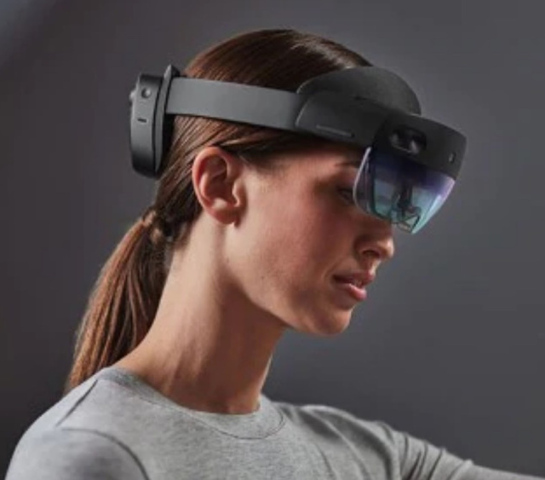
State of the Art The HoloLens 2
Released in 2019
$3500
Designed for industry, not consumers
Projects images onto glass lenses which reflect to eye

Slide 52


AR Software Development
Google provides ARCore
Unity will provide AR Foundation
For now…Vuforia is the best Unity option

Slide 53
Acknowledgments
Some material taken from :
Augmented Reality: Applications in Manufacturing and Maintenance
by SUN Jing
Aela GOURLAOUEN
QIU Zhi
Francois LEROY
Rostislav DOGANOV
Thomas Joseph Traviño SEVILLA

